Slide 1
Vindolanda
By: Chris Morville

Slide 3
Location

Slide 4
Site History
AD43 - Claudian armies conquer the South of England, forming first Roman frontier in Britain
AD117 – British rebel, failing to overthrow Roman rule
AD121-122 – Emperor Hadrian commissions Hadrian’s Wall to further strengthen Vindolanda

Slide 5
Archaeological Discoveries
Black, oxygen-free soil kept thousands of artifacts in incredible condition for researchers to uncover
Site was destroyed and rebuilt several time
6,500 discarded shoes – only two complete pairs
Fully intact swords, Roman lettering, wooden toys among artifacts found

Slide 8
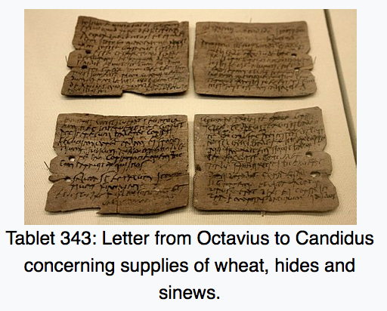
Vindolanda Tablets
At one point, the oldest surviving handwritten documents in Britain
Post-card size leaf-tablets, wood base, carbon-based ink
Over 700 talblets found
Still being recovered today

Slide 9
https://www.livescience.com/60379-photos-roman-fort-vindolanda.html
http://www.vindolanda.com/educate/history/timeline
https://en.wikipedia.org/wiki/Vindolanda
https://www.archaeology.org/issues/255-1705/features/5474-england-hadrians-wall-life
http://www.bbc.com/news/uk-england-tyne-43120942

